Slide 1
Optimizing the Nutrition Care Pathway
Projet Co-Création + Bank
5 avril

Slide 2












The First
360° Clinical Nutrition Management System
ASSESS
Early nutrition risk screening
TREAT
Fast, clinically validated nutrition planning & monitoring
FROM HOSPITAL→ HOME
INFORM
Automated Medical Devices monitoring from hospital to home
Notes:
Dim3 offers expert tools that trigger, assess and sustain a cycle of nutritional well being, improving care, operational efficiencies and reducing costs

Slide 3



Vivalia + DIM3
In parralel with Project
ING develops with Dim3 a
A Financial product of ING for MedTech integration in hospital

Slide 4
PRINCIPLE
Integration of a Medtech has a cost unbearable by hospital and by medtech companies
ING finances the integration trough a financial product dedicated to allow operative integration

Slide 5
PRINCIPLE
1. Hospital & Medtech have finalized a sustainable purchase agreement
2. ING has a financial tool allowing the hospital to purchase the tool trough a leasing … concept OR Vive Versa
3. The Medtech installs the product and is paid by Hospital or Bank .

Slide 6
FINANCEMENT
Example Dim3
Install
Adaptation
Training
24/24 technical assistance
Licence first year
Sold 125.000 €
Annual Licence
Around 50.000 €
Reference to sell built with Vivalia
ROI by vivalia

Slide 7
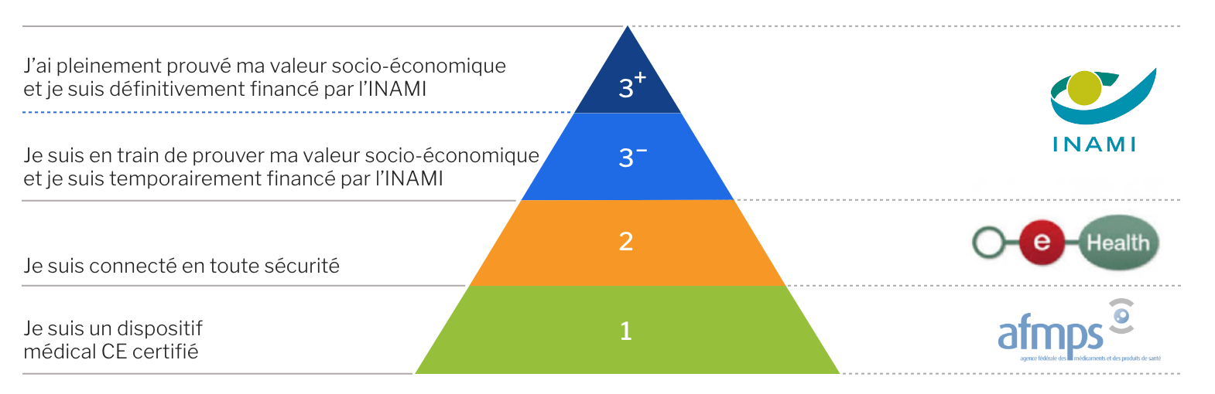

Slide 8
Merci
JEAN-CLAUDE HAVAUX
JC.HAVAUX@DIM3.COM
TELEPHONE: +32 475704830
www.dim3.com

